Slide 1
Degrees of comparison
Степени сравнения прилагательных

Slide 2

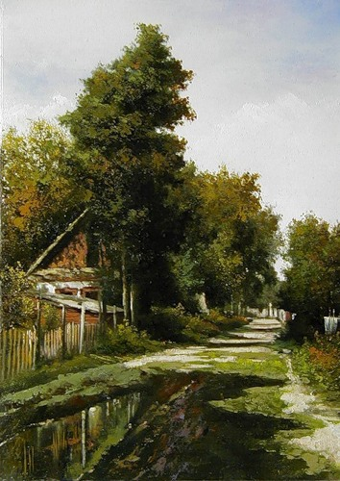

Which is better?

Slide 3
Степени сравнения прилагательных
положительная | сравнительная | превосходная
 | -er | the -est
warm | warmer | the warmest
dirty | dirtier | the dirtiest
big | bigger | the biggest
late | later | the latest
 | more | the most
beautiful | more beautiful | the most beautiful

Slide 4
Исключения
положительная | сравнительная | превосходная
good | better | the best
bad | worse | the worst
little | less | the least
many \ much | more | the most
far | farther | the farthest
 | further | the furthest

